Slide 1
MUSA
Building trust with transparency
Notes:
Consumer survey experience
Consumers monetize
Through simple/transparent platform
Users answer surveys, get reward
who They’re giving data too
This engaging, transparent platform
We’re creating a survey experience that let’s users monetize their opinions through a transparent platform. Users will complete surveys in exchange for a small reward. And will also be able to see which companies they’re giving their data to. This engaging, transparent platform will help Daimler build more long term loyalty with its current and future customers.
What is the app? WHo does it help? Why are we building this app? How can Diemler help?

Slide 2




Overview
Surveys
Rewards
Transparency
Loyalty

Slide 3
42% of people find brands less truthful than 20 yrs ago
Mccan
Notes:
We’re here today for a few reasons but this number really jumped out at us.

Slide 4

The shift
38%
Of users say that to build trust, users must know who’s using their data and how
Users demand more control
Source
Notes:
As we dig deeper, we’re seeing more evidence for this
This highlights a shift in market
They demand more control over their data:
They want to to know who and HOW
This is evidenced by this statistic
They demand brands engage them in new/interesting ways\
This is evidenced by the the rise of highly engaging social platforms like snapchat, instagram

Slide 5



The shift
Users demand engaging brands
Notes:
In this era, consumers are demanding a few things:
They demand more control over their data:
They want to to know who and HOW
They demand brands engage them in new/interesting ways
They demand brands engage them in new/interesting ways\
This is evidenced by the the rise of highly engaging social platforms like snapchat, instagram

Slide 6

Privacy losers
46% loss in 4th quarter
$18.5 million in fines
CEO is fired
Top 10 trusted → Top 30
Notes:
In 2013 Target suffered a data breach so bad that they posted a 46% loss in the 4th quarter…
But most importantly, their brand

Slide 7




Privacy losers...
$100s of millions in immediate cost
Priceless lost customer loyalty
Notes:
Around 2013 high profile data breaches happened at a bunch of large companies, this resulted in 100s of millions in immediate cost, but more importannt

Slide 8
After data breaches
86.55%
“not at all likely” or “not very likely” to do business with an company that had suffered a data breach
OnePoll
Notes:
A poll that was put out soon after these data breaches showed that 86.55% of customers

Slide 9
A profound change
“...trust (is) a necessary precondition for innovative products and services that rely on the processing of personal data”
-European Data Protection Supervisor Giovanni Butarelli
Notes:
“Now this is pretty profound and Europe responded with strong regulations to better protect consumers”

Slide 10
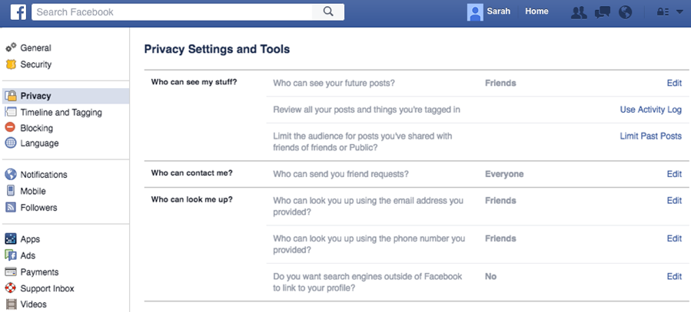
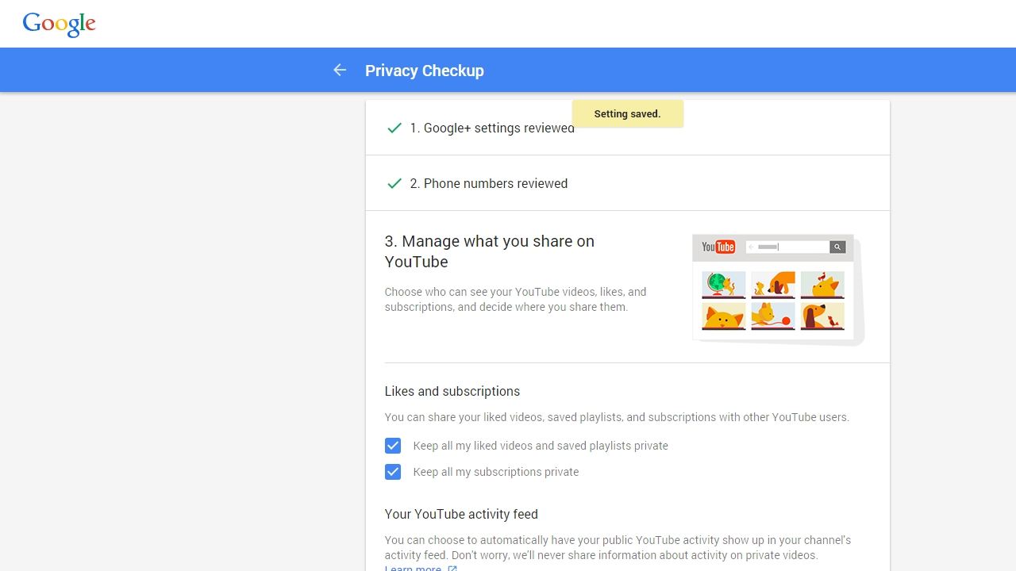
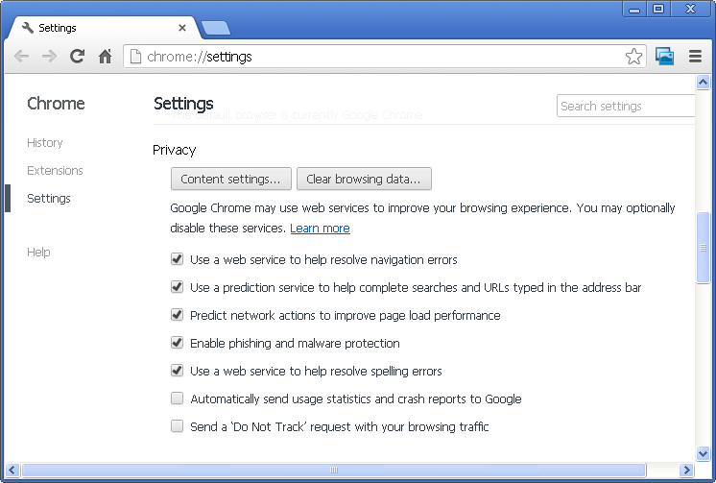
Privacy Losers
Notes:
Historically, companies like Facebook and Google make it intentionally very difficult for you to control your privacy/data (show examples)...
Most settings privacy settings are not well worded and buried in different settings tabs.

Slide 11
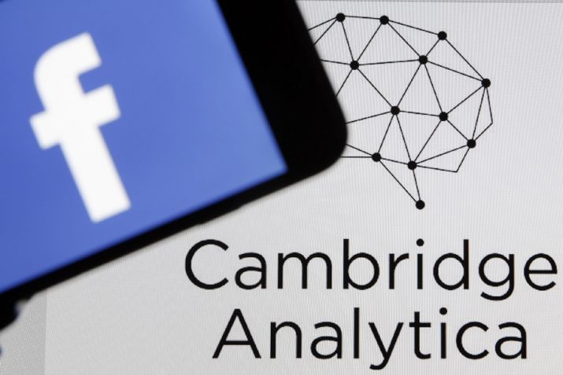
Privacy Losers
Lax data policies
3rd party apps misused data
4 years later…
Biggest scandal in privacy history
Notes:
Most recently, Facebook came under fire for their mishandling of user’s data
Because of lax data policies before 2013, FB gave access to users’ friends data to third party apps and they used that to
“FB was generously giving users data away to third parties, they were exteremely relaxed on privacy” “and… 4 years later it came to bite them in the ass”
The status quo is not an option anymore
The actual impact on FB stock/customer
Because of lax data policies before 2013, FB gave access to users’ friends data to third party providers and they used that to
“FB was generously giving users data away to third parties, they were exteremely relaxed on privacy” “and… 4 years later it came to bite them in the ass”

Slide 12



If we don’t adapt...
Trust
Engagement
Loyalty
Notes:
When companies don’t listen to the market, they suffer, and in this case, if companies don’t address these problems, customers will be less loyal, and less engaged.
Less trust =- less referrals
Lower engagement = less engagement online, clicks to site
Less loyalty = fewer generational ??

Slide 13
How can Daimler
stay ahead?
Notes:
So how can Daimler stay ahead of this curve and even leave a path for other companies to follow?
How can they win in this battle for long term customer loyalty?

Slide 14

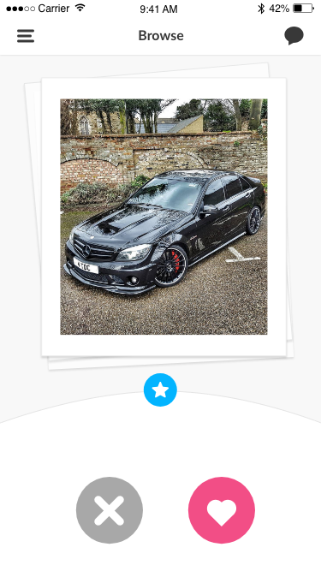
One platform
Notes:
“Engage” “Monetize” “Democratize”

Slide 15
Engage
(survey Q example mockup)
Notes:
Trusted partner companies distribute surveys through the platform, consumers answer surveys in exchange for a small reward.

Slide 16
Engage
(multiple surveys page)

Slide 17
Engage
(milestones mockup)

Slide 18
Control
(Analytics dashboard mockup)

Slide 19
Monetize
(Cashout page mockup?)
Notes:
Trusted partner companies distribute surveys through the platform, consumers answer surveys in exchange for a small reward.

Slide 20
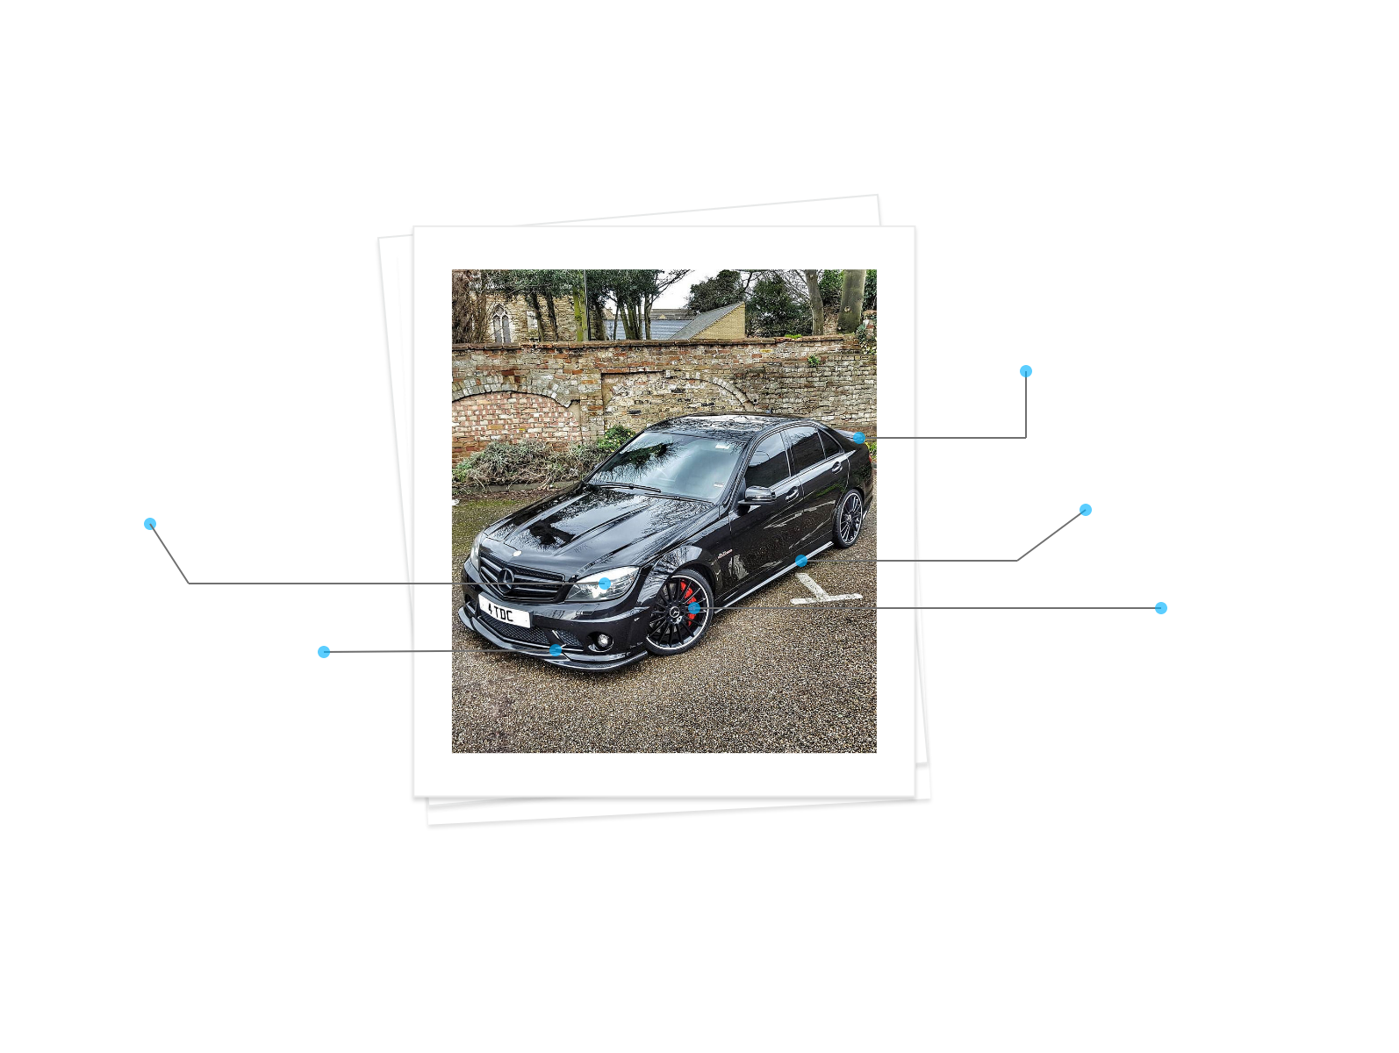

Slide 21


User profile
Notes:
The product of all this is a high res customer profile that both Daimler, and there partner companies can use in the battle for customer loyalty

Slide 22
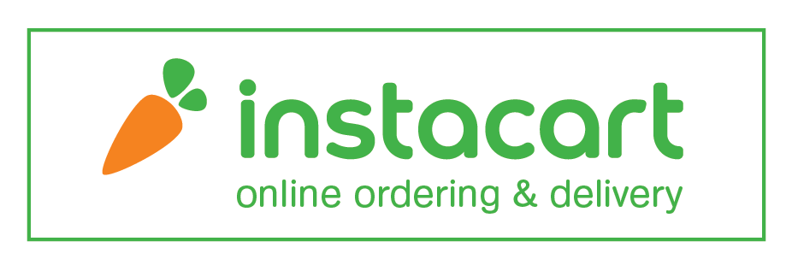
How it works
Company
Opinions
Insights
Notes:
For example: instacart could put a survey out

Slide 23
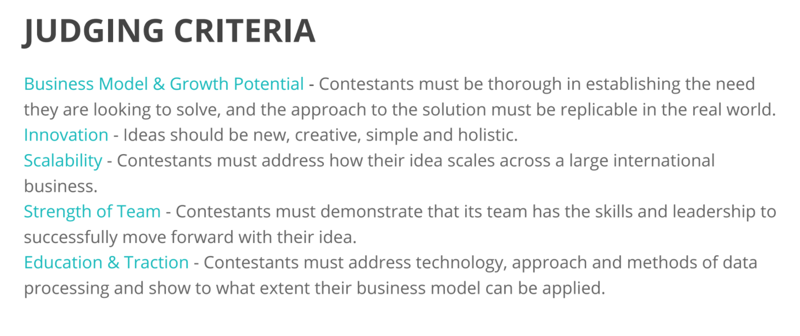


Distribution
Mercedes Pay
Notes:
We see this product fitting into a few different places. It could be seen as an added feature to existing mobility apps like mytaxi, Car2go, and others… It could also fit into the upcoming Mercedes Pay app as a “cashback survey system.” And lastly, you could target your existing customers to download a completely separate native application
Mention that there’s a huge market out there of users that use sub par shit like google rewards, etc… and that our product is better and why

Slide 24






Distribution
Mobility apps
Native app
Mercedes Pay
Notes:
We see this product fitting into a few different places. It could be seen as an added feature to existing mobility apps like mytaxi, Car2go, and others… It could also fit into the upcoming Mercedes Pay app as a “cashback survey system.” And lastly, you could target your existing customers to download a completely separate native application
Mention that there’s a huge market out there of users that use sub par shit like google rewards, etc… and that our product is better and why

Slide 25
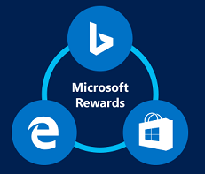
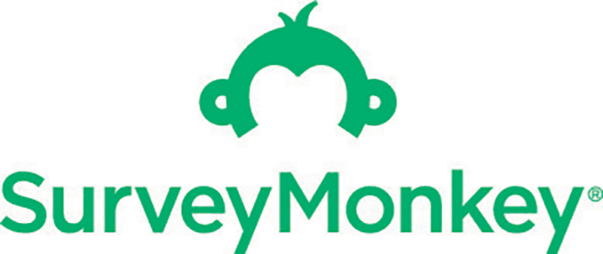
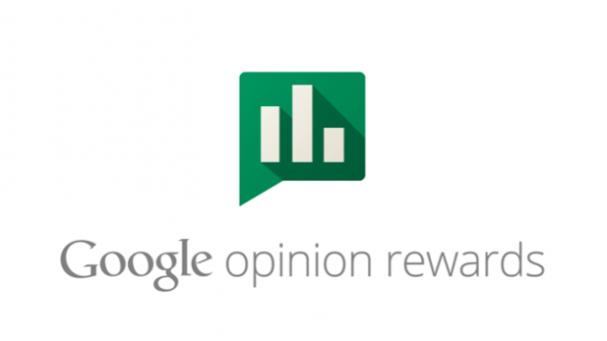

Competition
Notes:
You’re probably wondering what the competition is in this space?

Slide 26
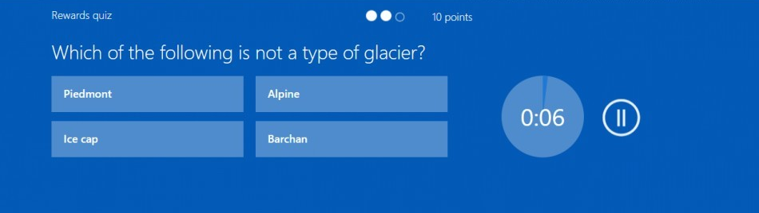
Competition
Focus on opinion rewards?
Engaging questions?
Data transparency
Notes:
There are competitors in the space that have millions of users,
Microsoft rewards, Survey Monkey, and Google opinion rewards.
None of them tell you where your data is going
And none of them are actually engaging… (show example of shitty survey)
Google surveys (embedded into websites, only 1
Each slide for each competitor
Final slide a summation of what we do and what they do (checklist style)

Slide 27
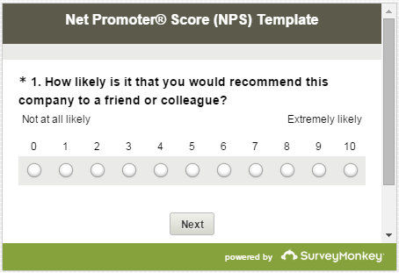

Competition
Data transparency?
Engaging questions?
Focus on opinion rewards?
Notes:
There are competitors in the space that have millions of users,
Microsoft rewards, Survey Monkey, and Google opinion rewards.
None of them tell you where your data is going
And none of them are actually engaging… (show example of shitty survey)
Google surveys (embedded into websites, only 1
Each slide for each competitor
Final slide a summation of what we do and what they do (checklist style)

Slide 28
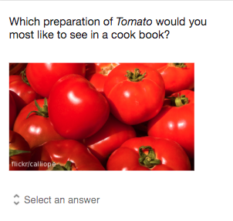
Competition
Data transparency?
Engaging questions?
Focus on opinion rewards?
Notes:
Not telling users where data is going.

Slide 29

The difference
Data transparency?
Engaging questions?
Focus on opinion rewards?
Data transparency?
Engaging questions?
Focus on opinion rewards?

Slide 30

If we DO adapt...
Trust
Engagement
Loyalty
Notes:
With stagnant competitors and an unstable political climate surrounding user privacy,
Daimler has the opportunity to fill a strategic gap in the customer survey market. Developing a more engaging, and more transparent survey platform will result in more, more trust (more referrals), more engagement (both online/offline) long term customer loyalty to Daimler.
MAke sure they

Slide 31
People trust honest people
companies
Notes:
Now that we’ve established that the status quo is not an option anymore, what questions do you have for us?

Slide 32
Next steps?
Notes:
Now that we’ve established that the status quo is not an option anymore, what questions do you have for us?

